Slide 2
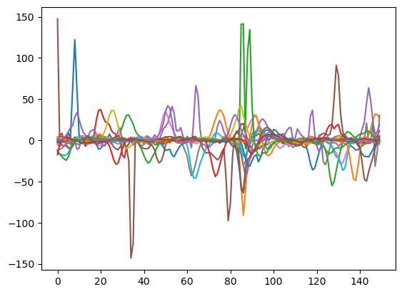
2024/08/23 – Base Experiment with CS in Free Flight Setup

Slide 3
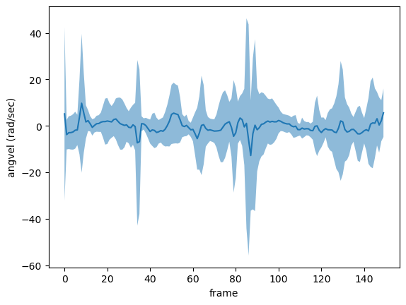

Slide 4
